Slide 1



Release: 0.4.x
Home page
Welcome to CardShifter.
News
Current mod:
Cyborg Chronicles
Dynamic content?
Web links
2014-10-20:
Tentative new GUI
Design begins.
Change mod
ARCHIVED
Single Player Game
Find more mods
RSS feed
2014-09-25:
Snapshot 0.4 now available.
Multi Player Game
Chat Lobby
Game Client
My Decks
Contact us / Report Bug
Phrancis
Picture links to profile on web
1,000
2 friends online
Exit
Notes:
Archived. Do not use.

Slide 2
Contact us / Report Bug
News
(RSS feed)
2014-10-20:
Tentative new GUI Design begins.
2014-09-25:
Snapshot 0.4 now available.
Release notes:
Foo bug is fixed.
Bar support is added.
Baz feature has been added.
Release: 0.4.x
Welcome to CardShifter.
Current mod:
Cyborg Chronicles
Change mod
Find more mods
Home page
Phrancis
1,000
2 friends online
Solo Game
Multi Player Game
View Decks
Exit
Notes:
Modifications suggested by @skiwi: Maybe put account and friend status in a new bottom bar, then bunch up all menus on the left, and use the center part (about 70%) for the "homepage", including the welcome/mod and news

Slide 3
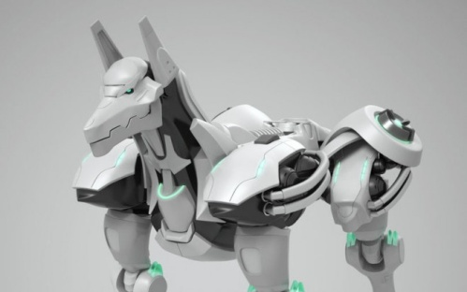
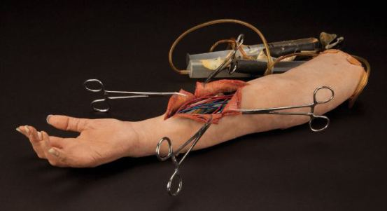

Fighter
$2
Steel Hound
$3*2
Bionic Arm
#3
i
Effect Name
Effect Name
Effect Name
Effect description
Effect description
Effect description
“Fighters like these are common on the streets.”
“A fierce canine made of tough steel.”
“This arm adds strength to even the most puny human.”
Bio
2/1
B0T
4/2
Upgrade
+3 / 0
Fighter
i
Steel Hound
i
Bionic Arm
i
Effect Name
Effect Name
Effect Name
$3
$3*2
#3
Bio
2/1
B0T
2/1
2/1
Notes:
Card size: 3.5” x 2.5” (1.4:1)
Image size: 1.4” x 2.25” (1:1.6)
Text box size: 1.3” x 2.25” (1:1.75)
$ mana cost / # scrap cost / * scrap value

Slide 4





WITH ICONS
Longshot
3
Modleg Ambusher
5
3
Bionic Arms
1
i
Ranged
Rush
Suffers no damage when attacking.
No cast sickness.
“Eyes and reflexes augmented for maximum deadliness.”
“Uses the legs of other bots to enhance its own speed.”
“These arms will give strength to even the most puny individual.”
Bio
3 2
Mech
5 3
Upgrade
+2 0
Longshot
i
i
Bionic Arms
i
Modleg Ambusher
Ranged
Rush
3
5
3
1
Bio
3/2
Mech
5/3
Upg
+2/0
Notes:
Card size: 3.5” x 2.5” (1.4:1)
Image size: 1.4” x 2.25” (1:1.6)
Text box size: 1.3” x 2.25” (1:1.75)
$ mana cost / # scrap cost / * scrap value

Slide 5





ICONS
Notes:
Card size: 3.5” x 2.5” (1.4:1)
Image size: 1.4” x 2.25” (1:1.6)
Text box size: 1.3” x 2.25” (1:1.75)
$ mana cost / # scrap cost / * scrap value

Slide 6
Phrancis
1,000
Active Deck
CardShifter Deck Builder
6 / 30
Deck List
2 friends online
Longshot
i
Longshot
i
i
Bionic Arms
i
3
Phrancis1
6/30
Modleg Ambusher
Modleg Ambusher
i
2
Bionic Arms
i
1
Ranged
Rush
3
5
3
1
Bio
3/2
Mech
5/3
Upg
+2/0
3/3
2/3
1/3
Rename Deck
Prev
Next
Load Deck
Delete Deck
Save Deck
Start Game
Notes:
Deck builder

Slide 7
Phrancis
1,000
AI Players
CardShifter Lobby
5 friends online
1-Loser
22-Oct 17:33 | Server Chat: Zomis has joined the chat
22-Oct 17:33 | Phrancis: Hi @Zomis how are you?
22-Oct 17:33 | bazola: hey Simon
22-Oct 17:33 | Zomis: Hey guys, anyone up for a game?
Users online
bazola
i
GreyFox
i
Phrancis
i
skiwi
i
Zomis
i
Invite
Type message here
Clear
Deck Builder
Send
Main Menu
Notes:
Deck builder

Slide 8





Phrancis
Points: 10,000
3 friends online
Zomis
Points: 10,000
Buiding decks
Play
Bazola
Points: 10,000
In game
Play
GreyFox
Points: 10,000
In lobby
Play
Skiwi
Points: 10,000
Offline
Play
Notes:
Friends list

Slide 9
Phrancis
Legend : Active
Can Attack|Targetable
Health: 9
Scrap: 2
Mana: 0
Mana max: 9
Cards left: 15
Chat
Phrancis:
Ouch! Nice move.
Zomis
Hehe thanks.
Turn: 9
Health: 22
Scrap: 0
Mana: 2
Mana max: 9
Cards left: 14
Done
Cancel
Zomis
End Turn
Notes:
In-game board

